Slide 1
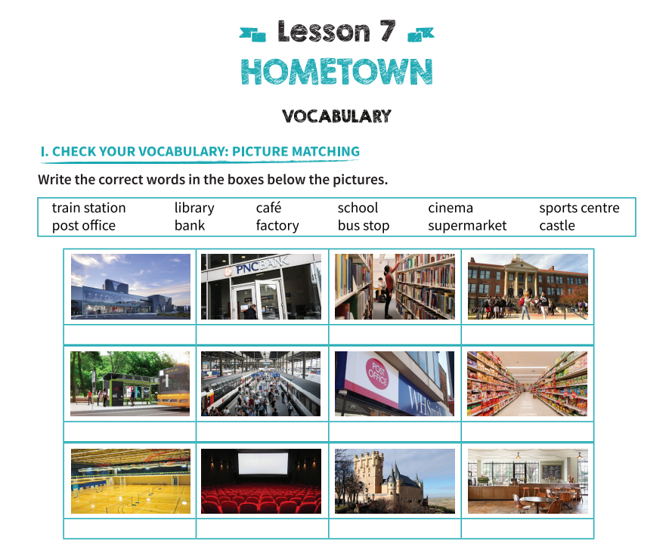
factory
bank
library
school
bus stop
train station
post office
supermarket
sports centre
cinema
castle
café

Slide 2
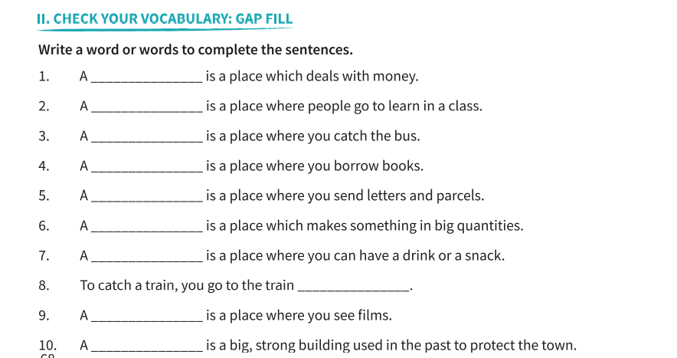
bank
school
bus stop
library
post office
factory
café
station
cinema
castle

Slide 3
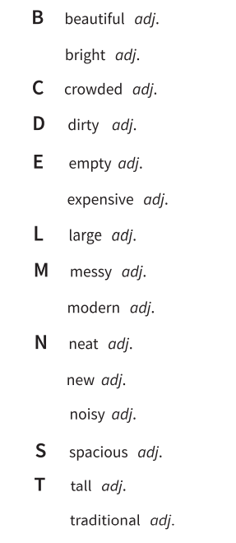
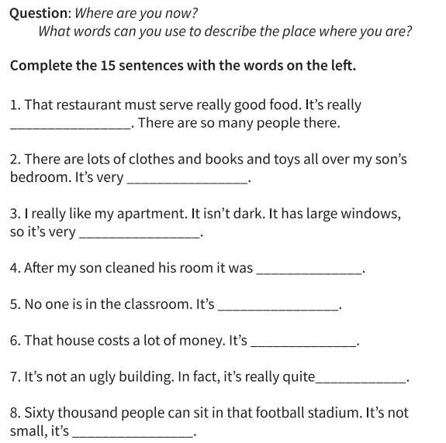
crowded
messy
bright
neat
empty
expensive
beautiful
large

Slide 4
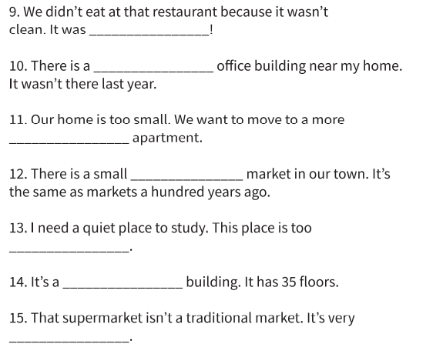
dirty
new
spacious
traditional
noisy
tall
modern

Slide 5
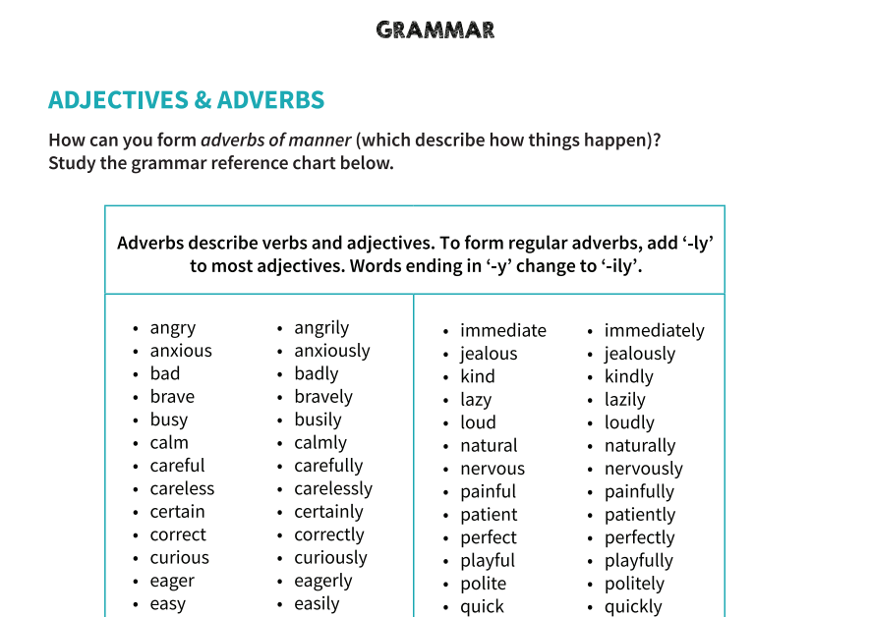

Slide 6
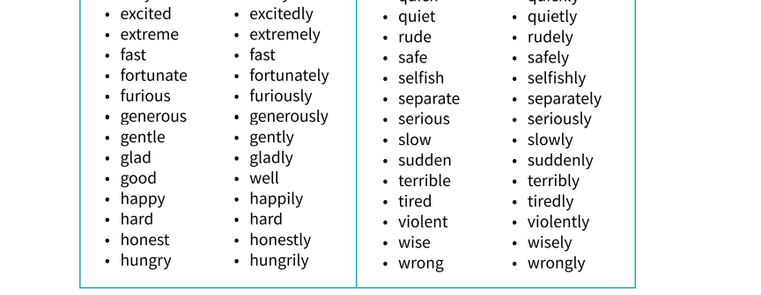
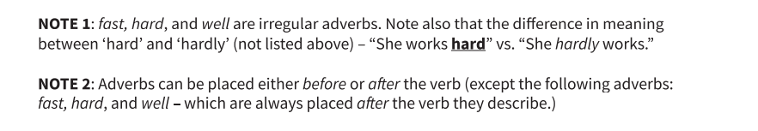

Slide 7
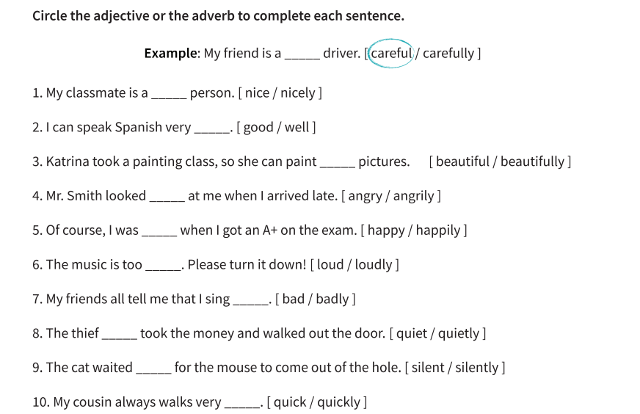

Slide 8
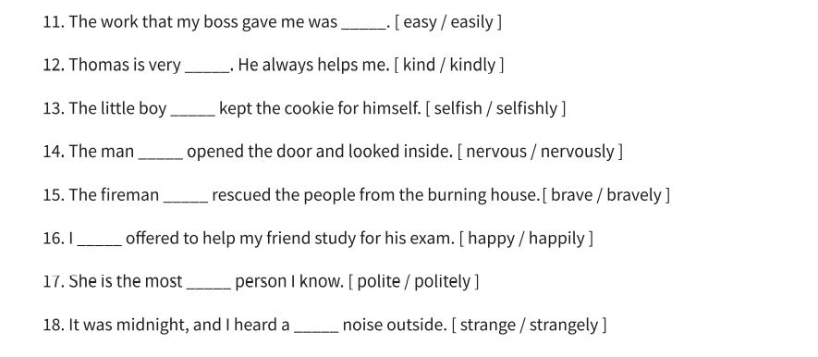

Slide 9
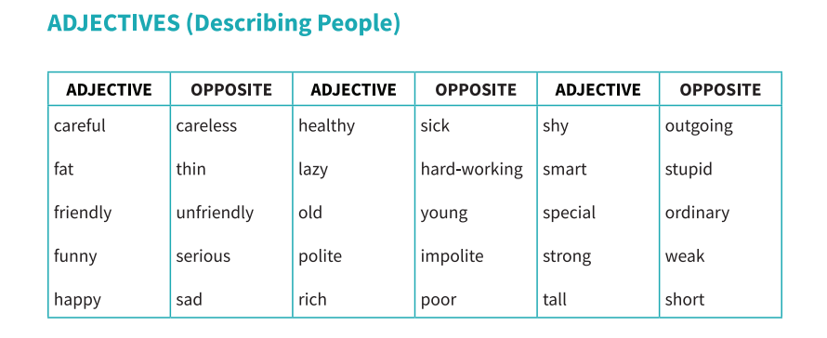

Slide 10
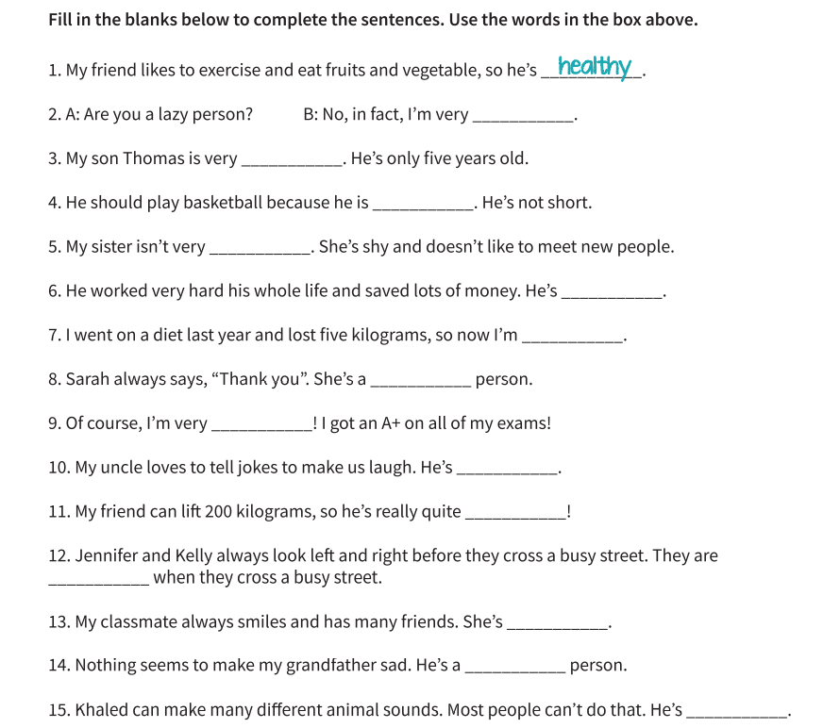
hard-working
young
tall
outgoing
rich
thin
polite
smart
funny
strong
careful
friendly
happy
special

Slide 11
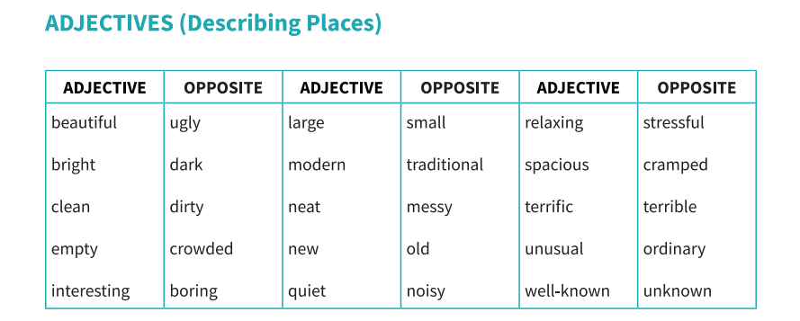

Slide 12
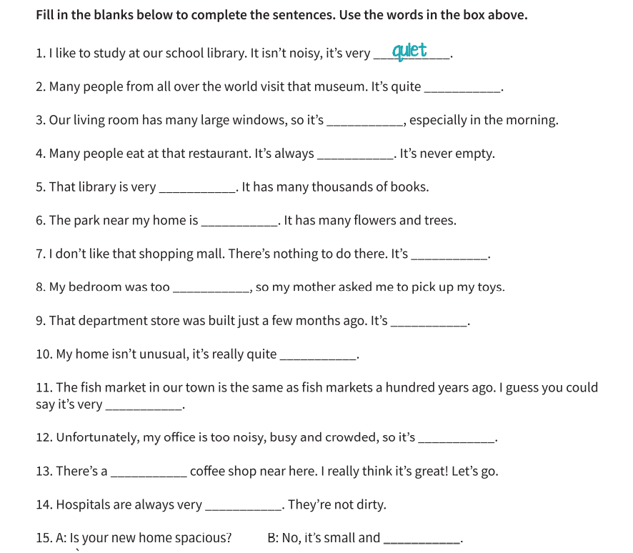
well-known
bright
crowded
large
beautiful
boring
messy
new
ordinary
traditional
stressful
terrific
clean
cramped

Slide 13
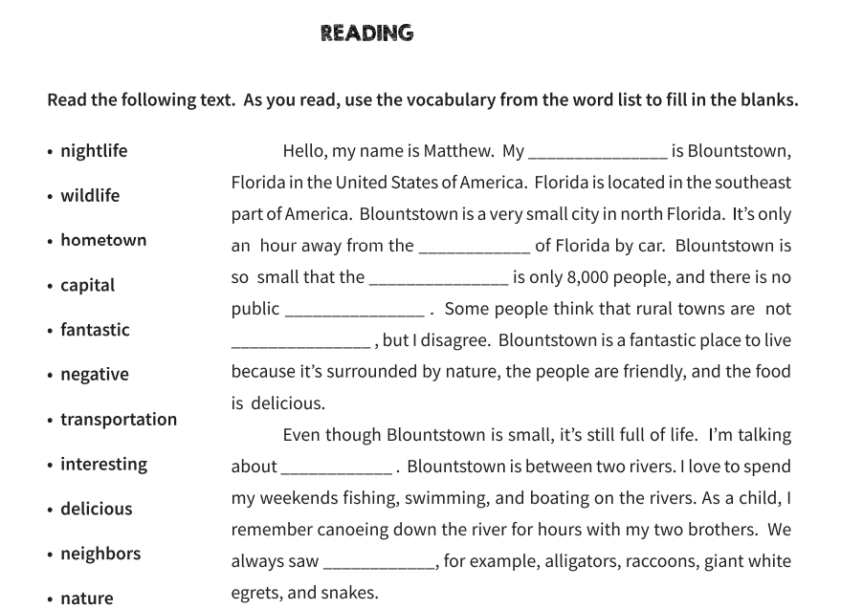

hometown
capital
population
transportation
interesting
nature
wildlife

Slide 14
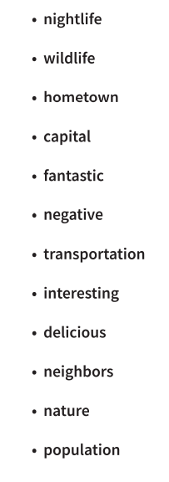
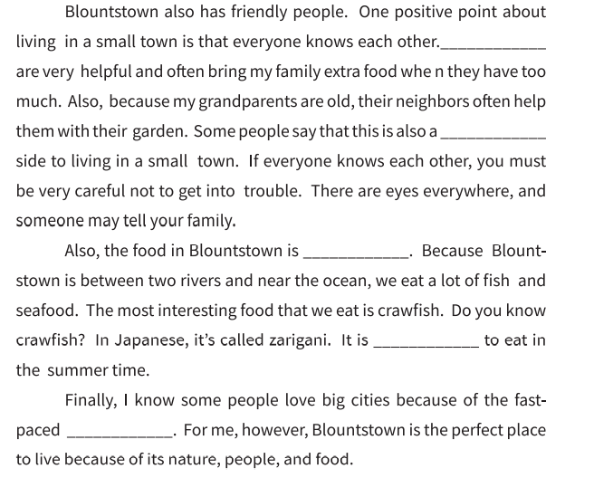
Neighbors
negative
delicious
fantastic
nightlife

Slide 15
